Slide 1

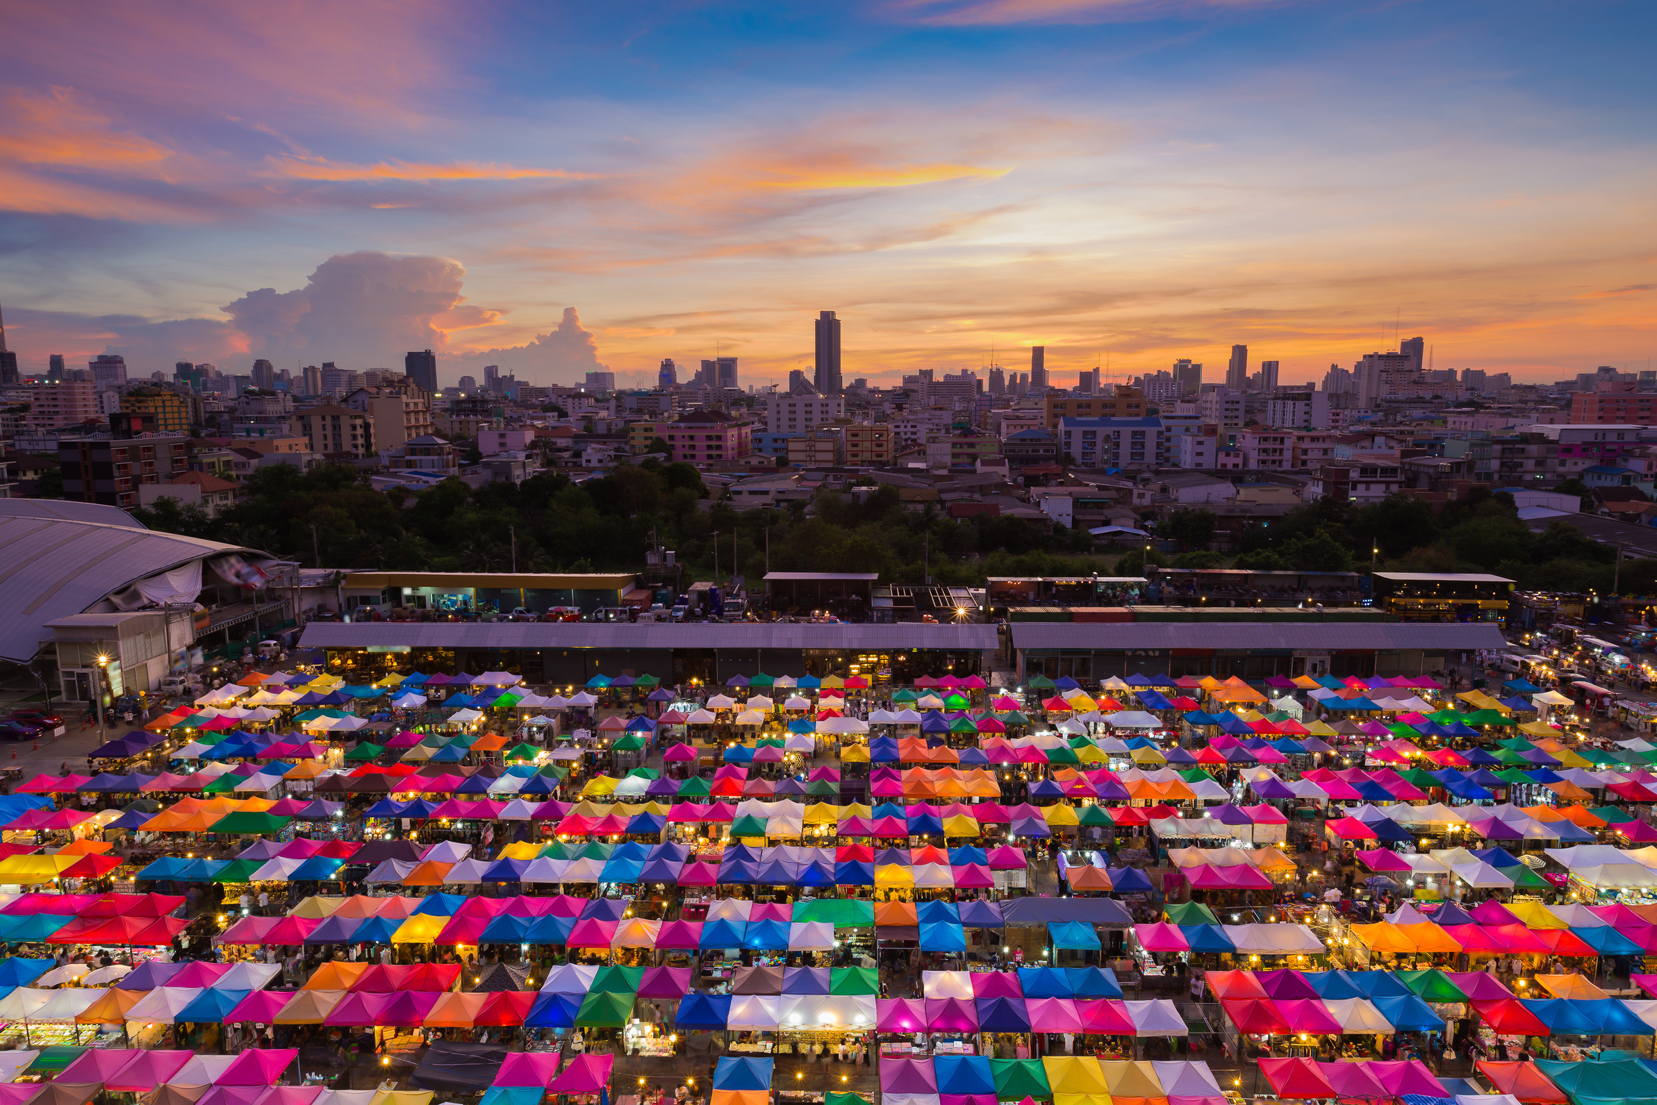
"Diverse Creations: Mall Experience with Chanxe Solutions"
Embark upon a journey through the portal to Diverse Creations, where mall events transcend the mundane and enchant the senses.
Notes:
1

Slide 2

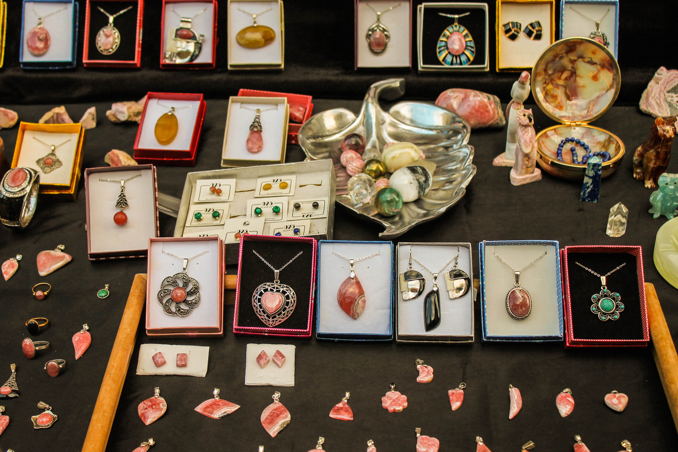


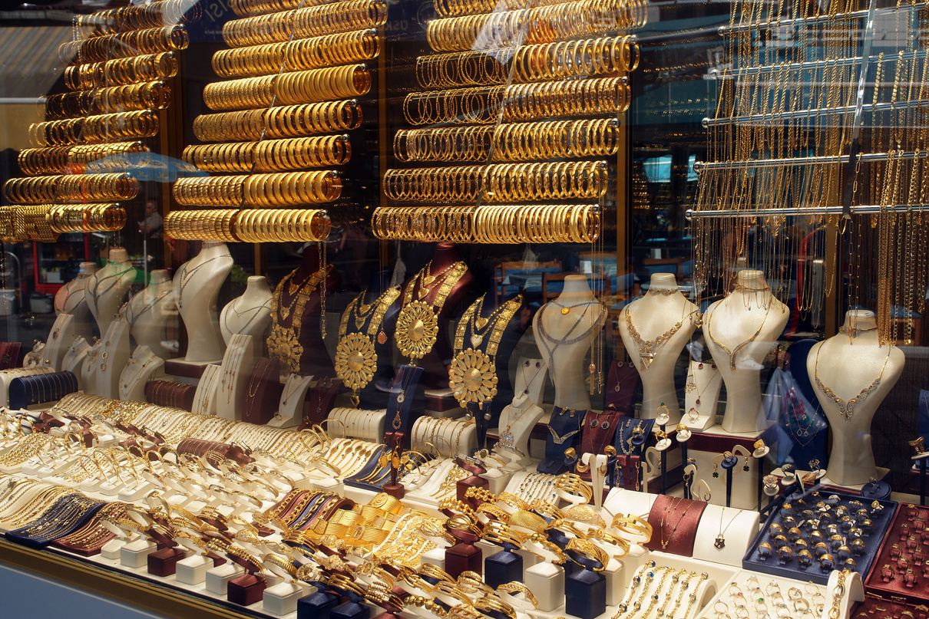
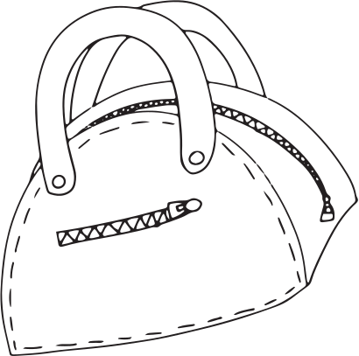
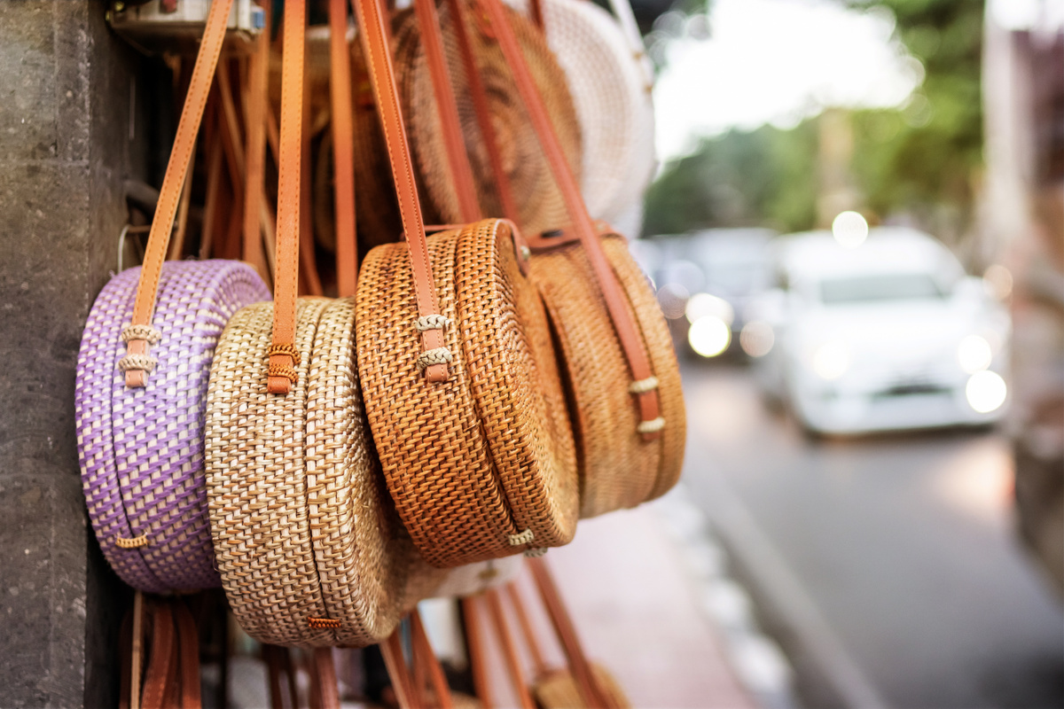
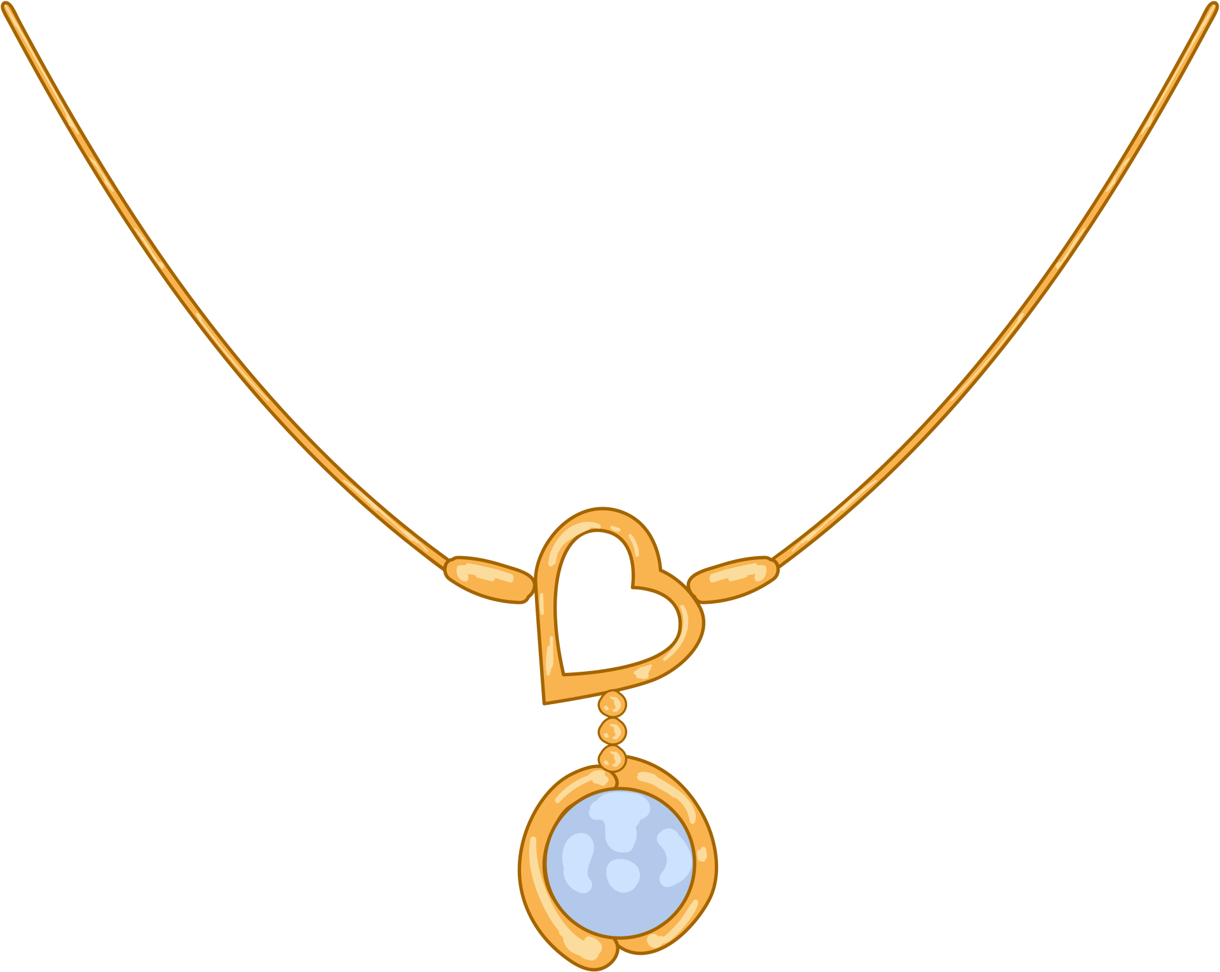


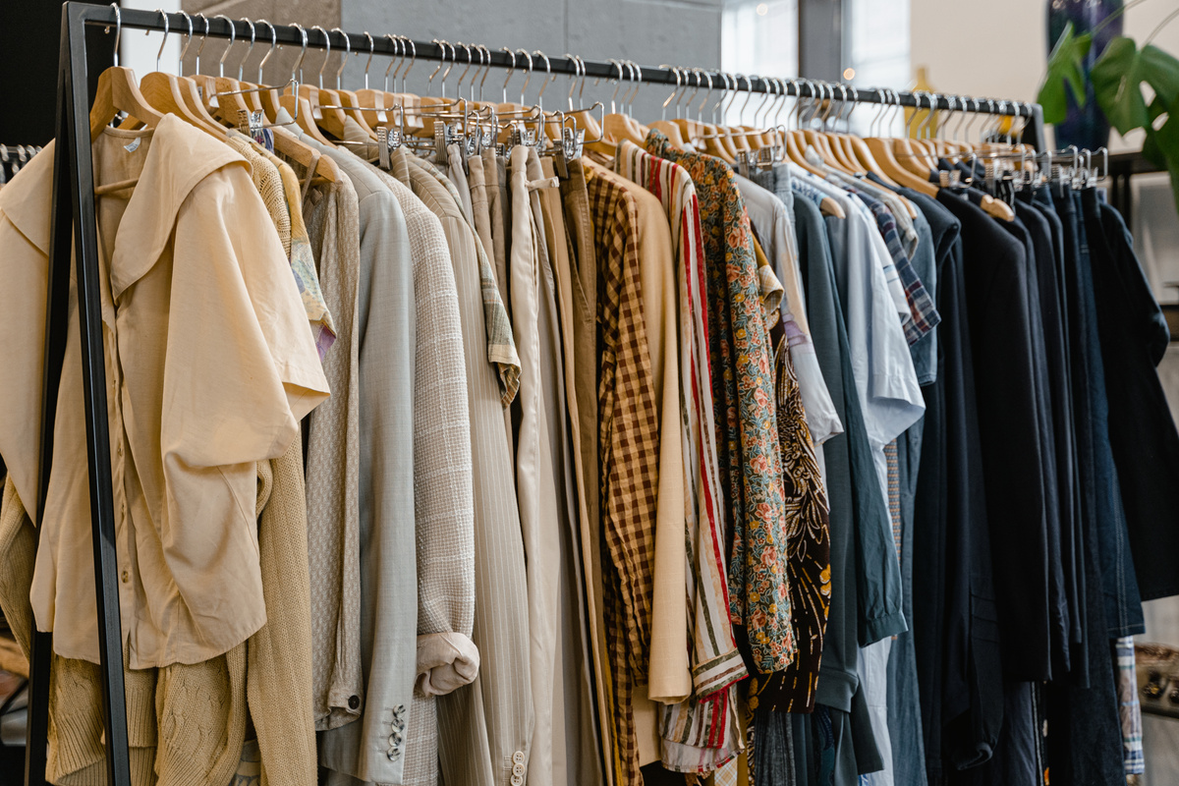

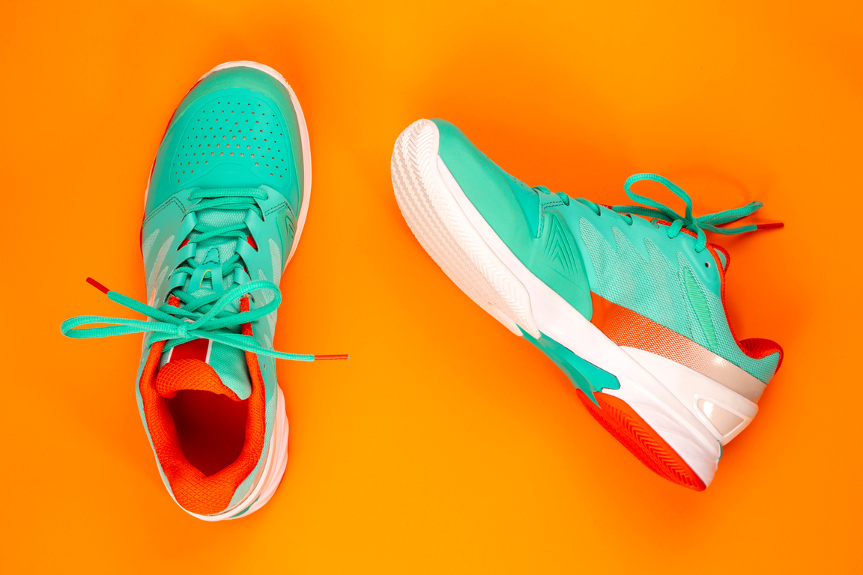

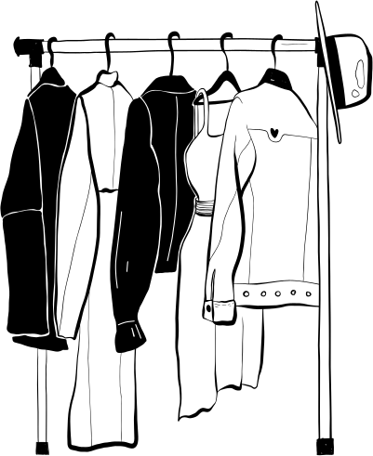


Fashion and Accessories
Stylish Bags
Find the perfect bag to complete your look.
Exquisite Jewelry
Add a touch of elegance with our exquisite jewelry pieces.
Trendsetting Clothing
Explore the latest fashion trends and styles.
Comfortable Shoes
Step out in comfort and style with our footwear collection.
Notes:
2

Slide 3



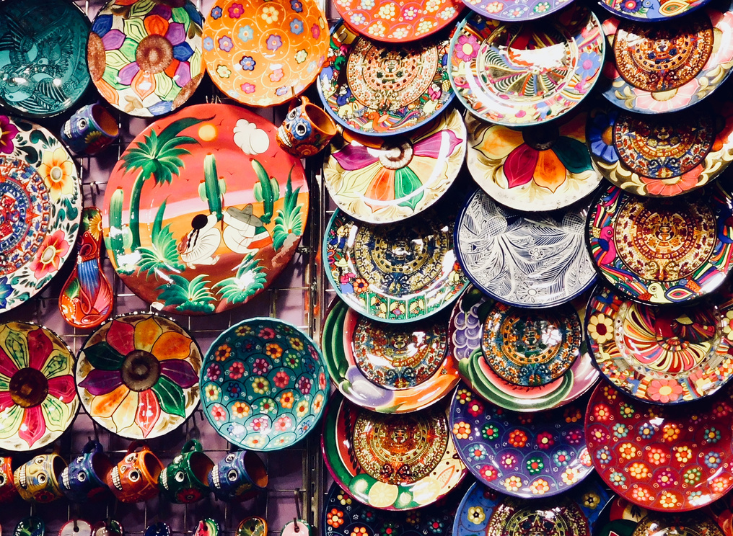
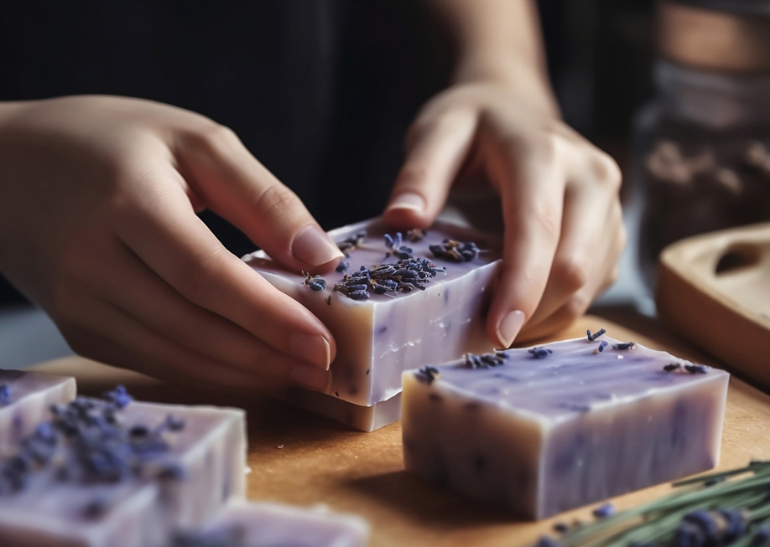



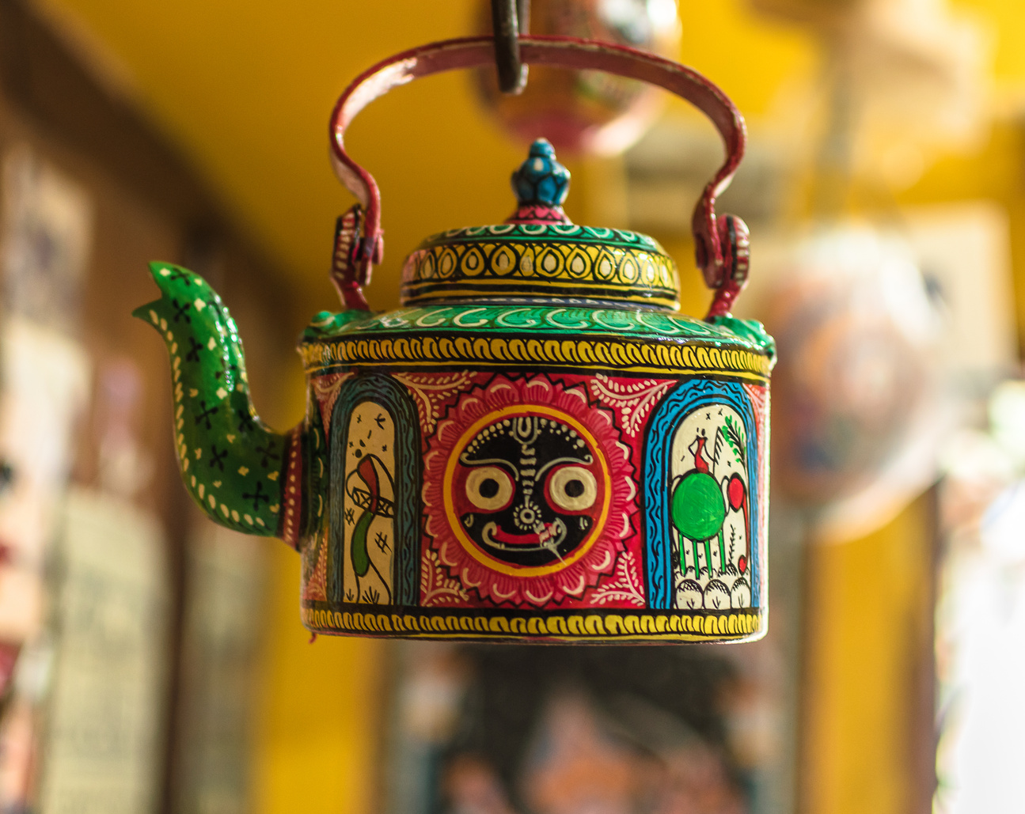

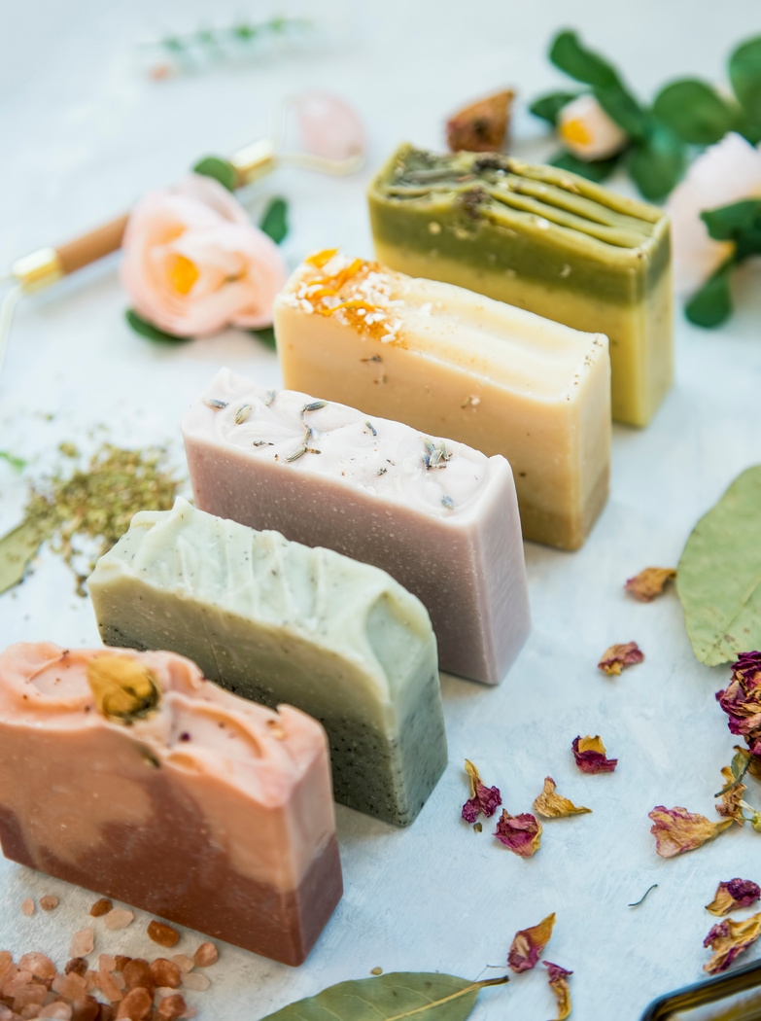
Home and Lifestyle
Weave your haven with our bewitching and unparalleled treasures for your home and lifestyle.
Unique Handcraft
Discover one-of-a-kind handcrafted items for your home.
DIY Products
Create personalized items with our unique DIY products.
Artistic Decor
Enhance your living space with artistic and creative decor pieces.
Luxurious Handmade Soaps
Pamper yourself with luxurious handmade soaps.
Notes:
2

Slide 4

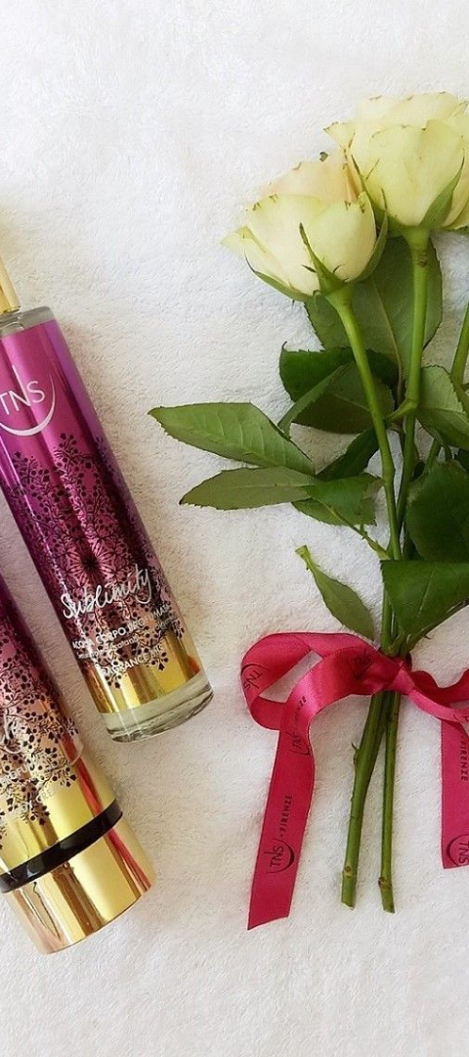

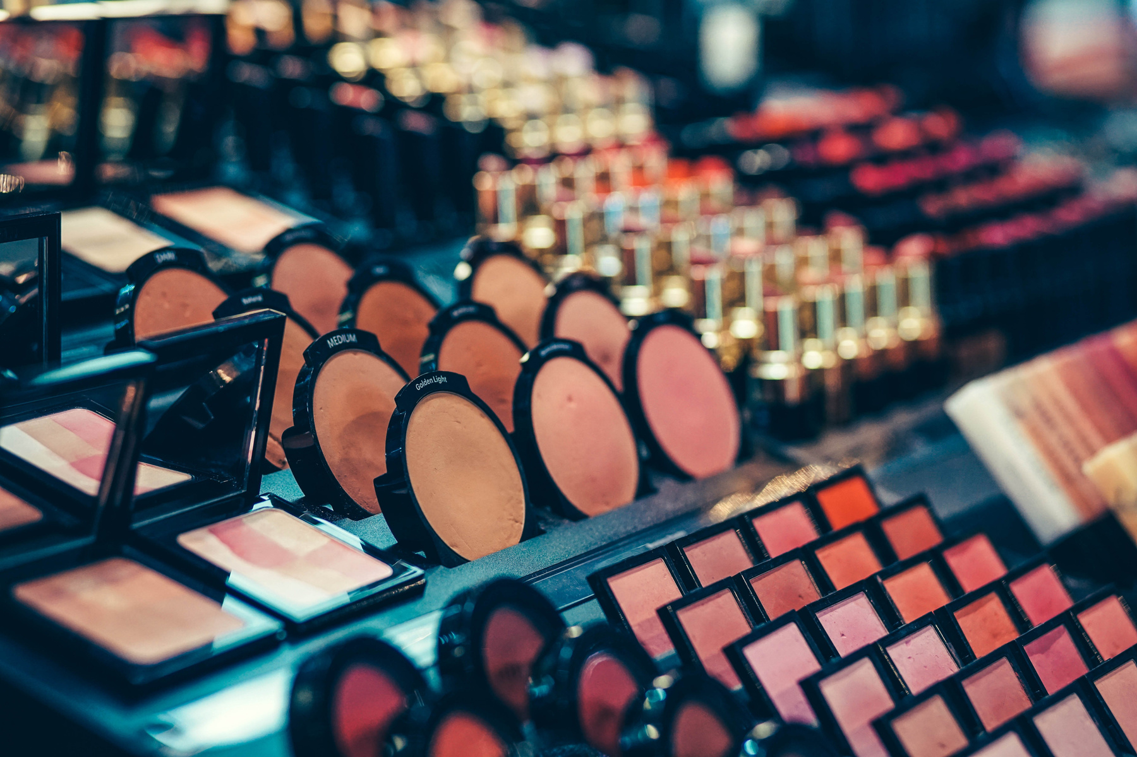

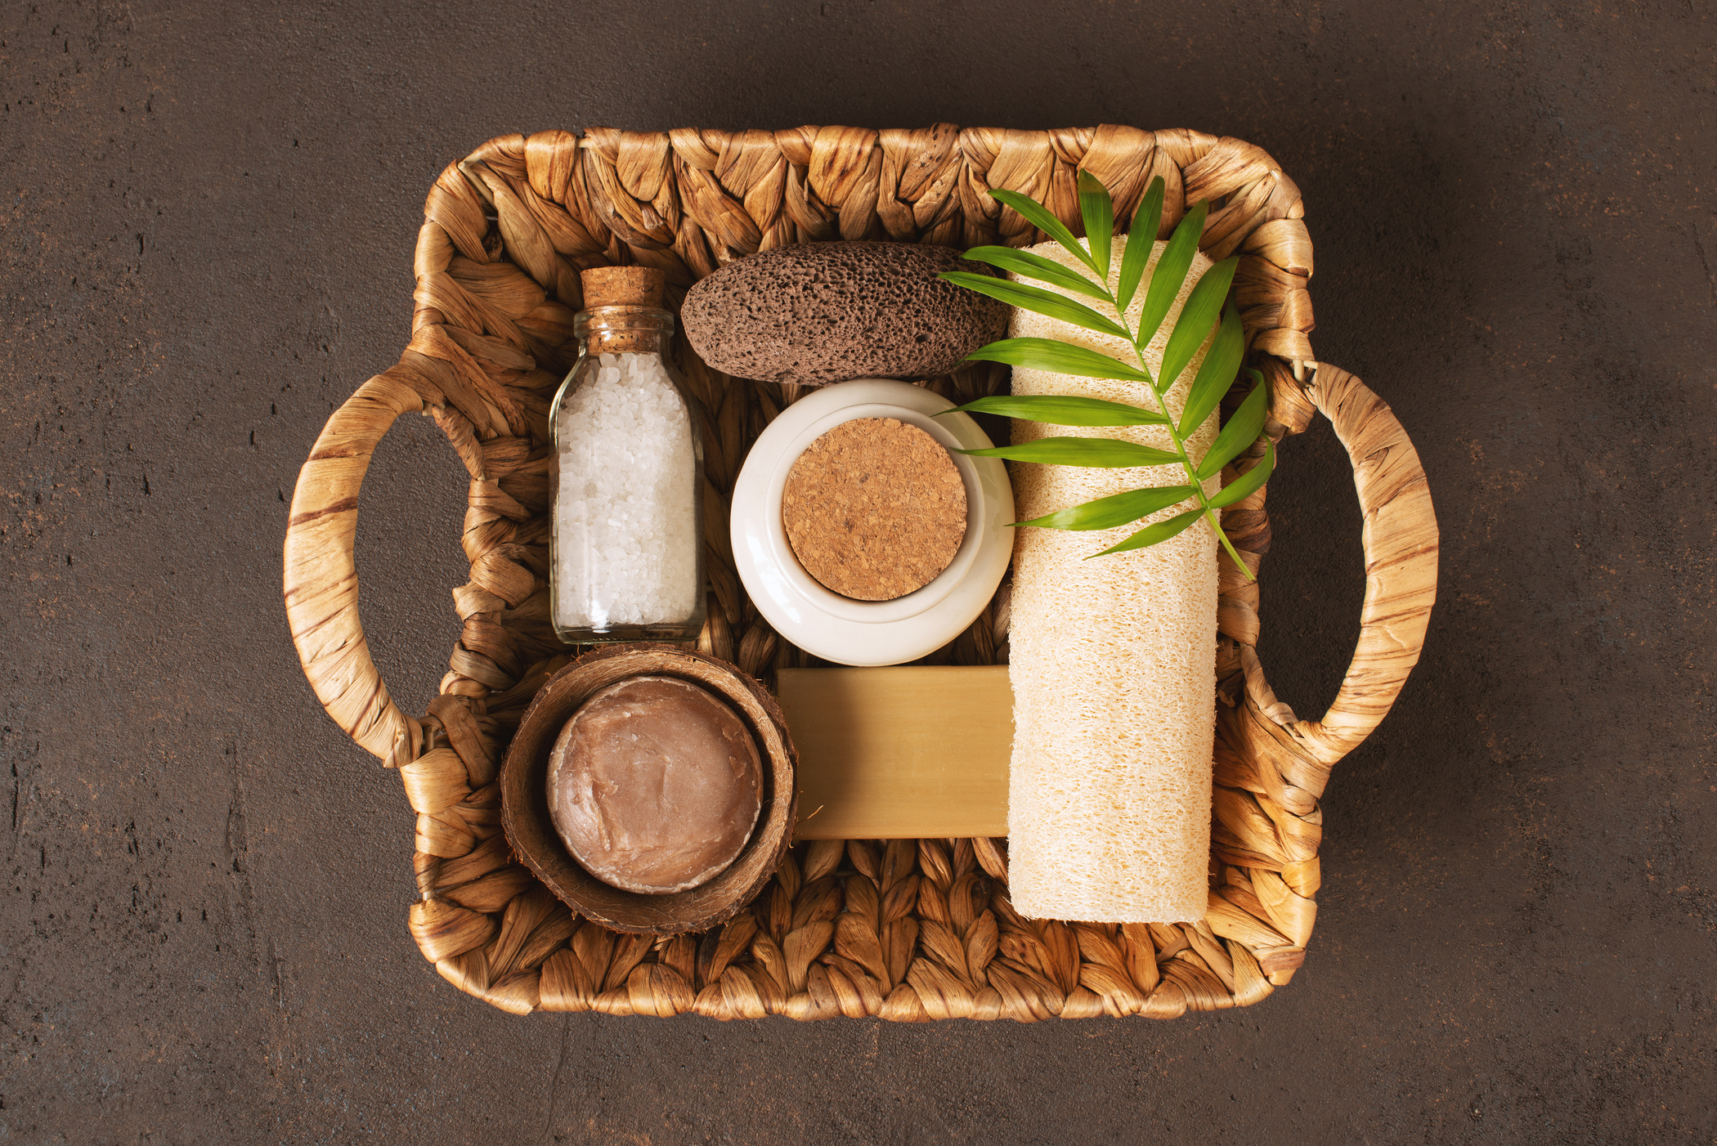


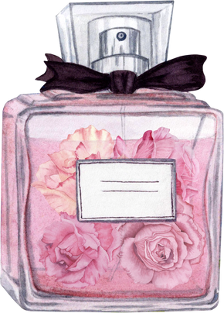
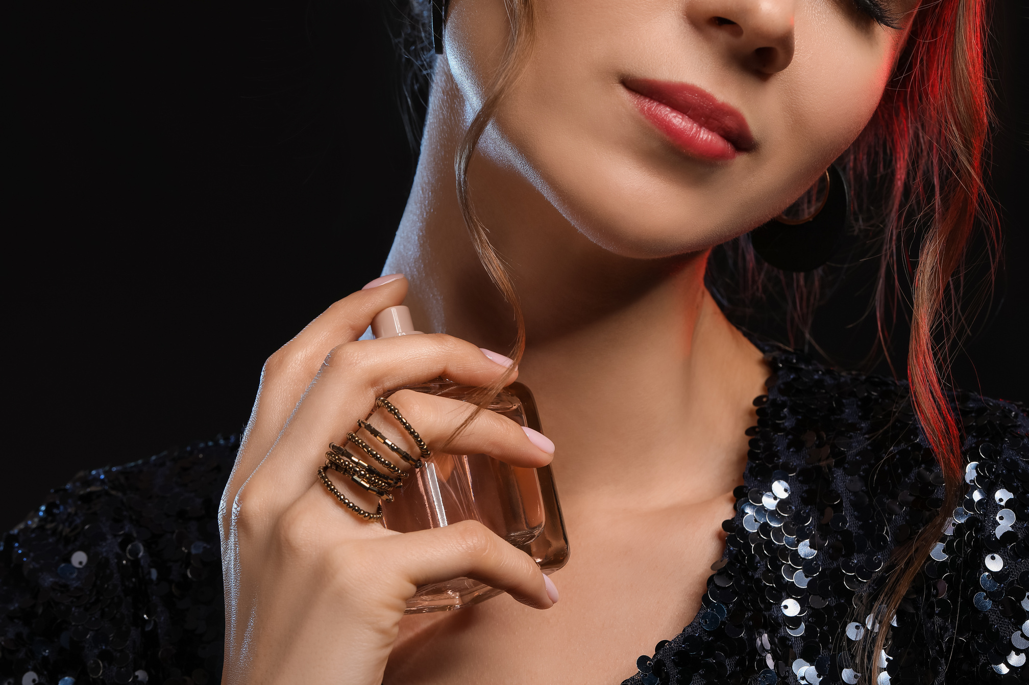

Beauty and Personal Care
Glamorous Cosmetics
Discover a range of glamorous beauty products.
Nourishing Skin Care
Nourish and rejuvenate your skin with our skincare range.
Captivating Perfumes
Find captivating scents that express your unique style.
Notes:
4

Slide 5









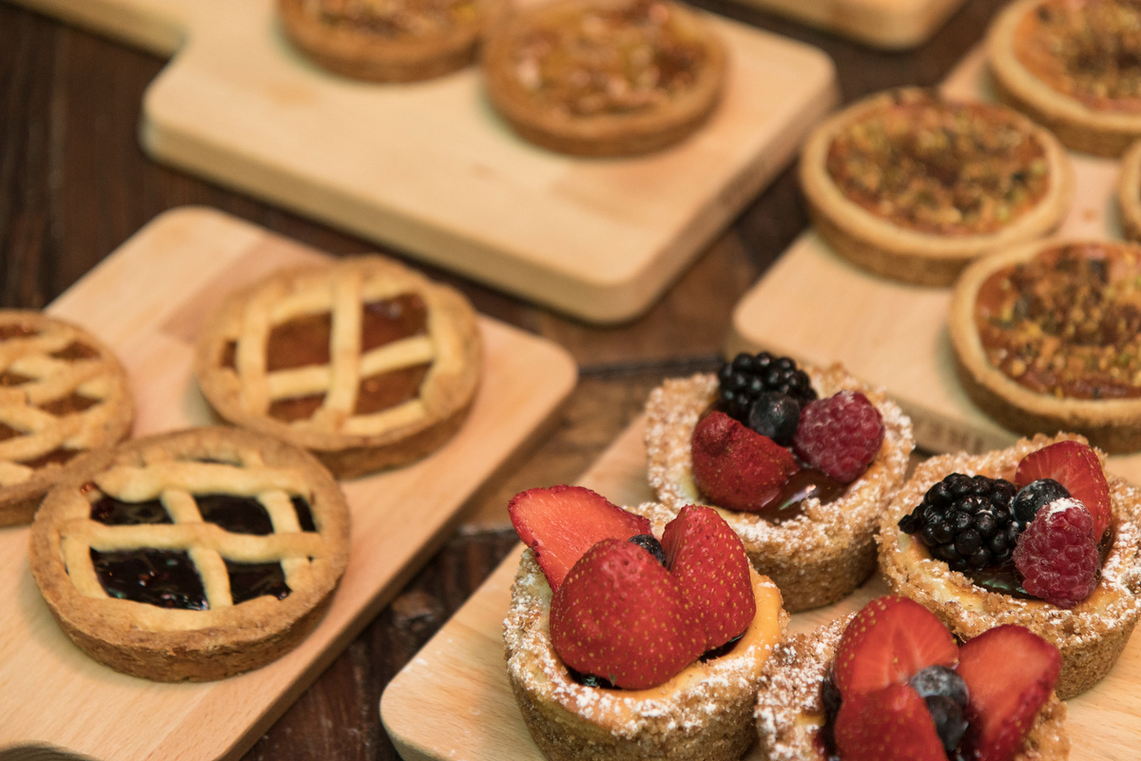

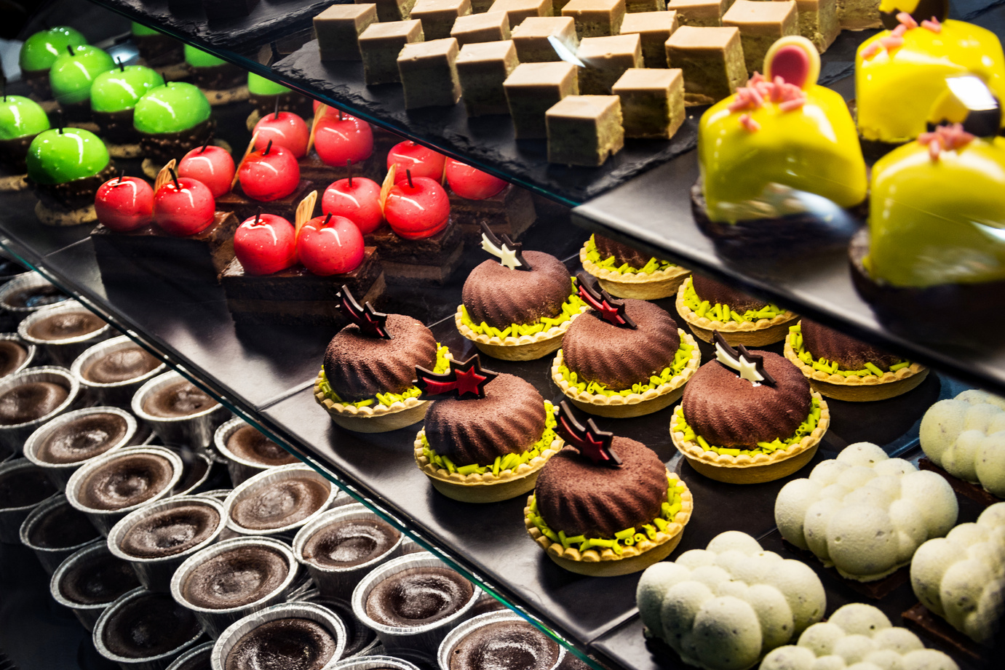

Gourmet and Culinary
Savor exquisite flavors with our gourmet and culinary delights, from delicious bakery items to aromatic spices and specialized beverages."
Aromatic Spices
Explore a world of aromatic and flavorful spices.
Delicious Bakery Items
Indulge in a variety of delectable bakery treats.
Specialized Beverages
Quench your thirst with our specialized beverage selection.
** live food & snacks are subject to approval from the mall**
Notes:
5

Slide 6
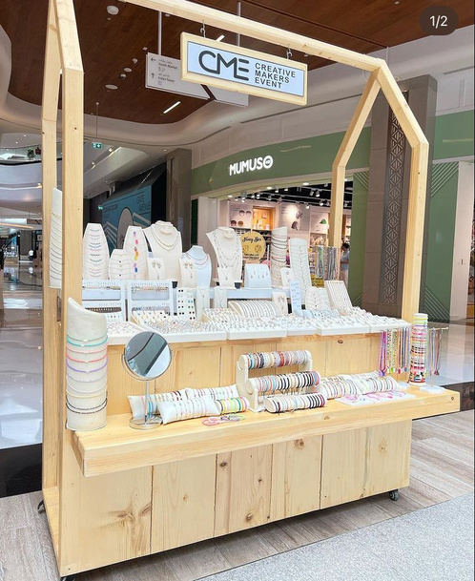
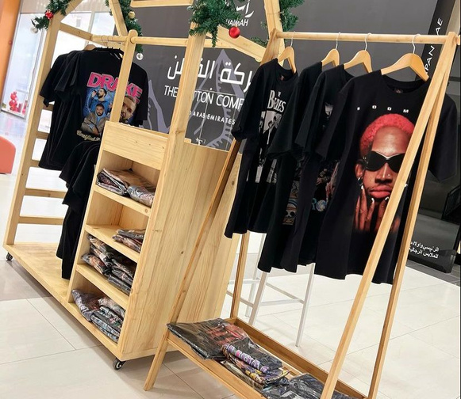
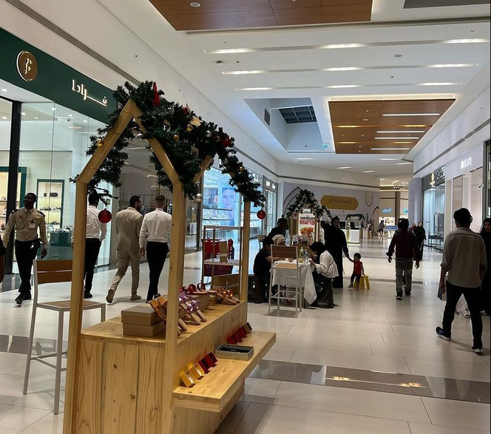

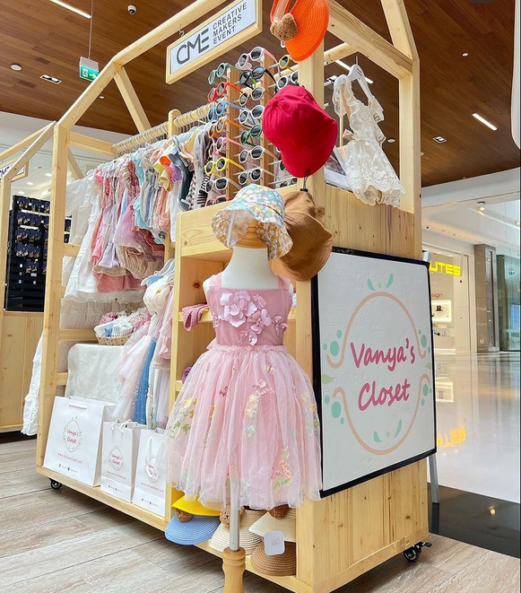
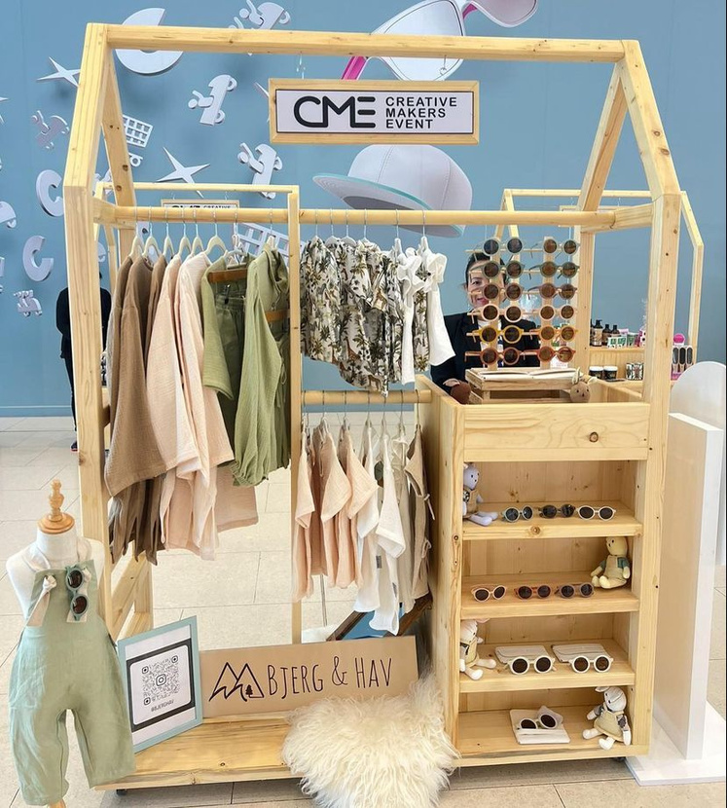


Chanxe Creations: Enchanting Your Experience with a Magical Touch
"Transforming spaces with enchanting displays, we specialize in creating magical visuals for an extraordinary aesthetic experience."
JOIN US FOR AN
Picture
perfect event
Notes:
5

Slide 7



Chanxe Solutions: Elevating Your Spaces
Transform Your Environment into a Haven of Sophistication and Beauty
Discover how we can assist you in achieving this goal by getting in touch with us! Check out our booth if you're in India, or simply contact us for further information.
INDIA
CONTACT US
0563842601 OR Chanxesolutions@gmail.com
or visit www.chanxe.vercel.app
Notes:
6

